Slide 1

Process-to-Process Delivery: UDP, TCP, and SCTP
23.1
Copyright © The McGraw-Hill Companies, Inc. Permission required for reproduction or display.

Slide 2











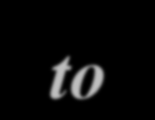




























PROCESS-TO-PROCESS DELIVERY
The transport layer is responsible for process-to- process delivery—the delivery of a packet, part of a message, from one process to another. Two processes communicate in a client/server relationship, as we will see later.
Topics discussed in this section: Client/Server Paradigm Multiplexing and Demultiplexing
Connectionless Versus Connection-Oriented Service Reliable Versus Unreliable
Three Protocols
23.2

Slide 3

Note
The transport layer is responsible for process-to-process delivery.
23.2

Slide 4
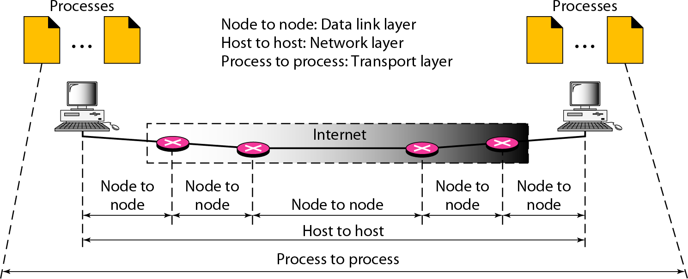
Types of data deliveries
23.2

Slide 5
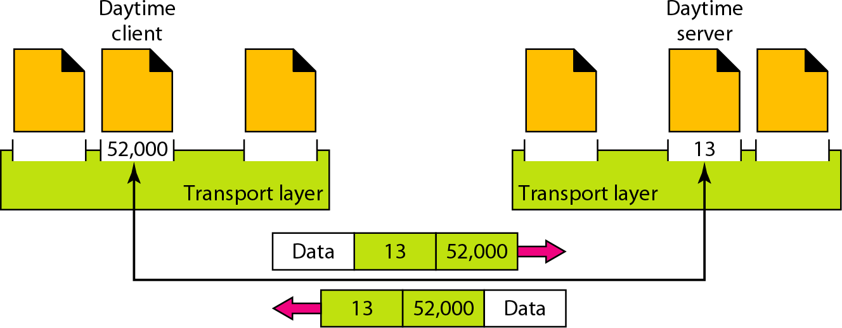
Port numbers
23.2

Slide 6
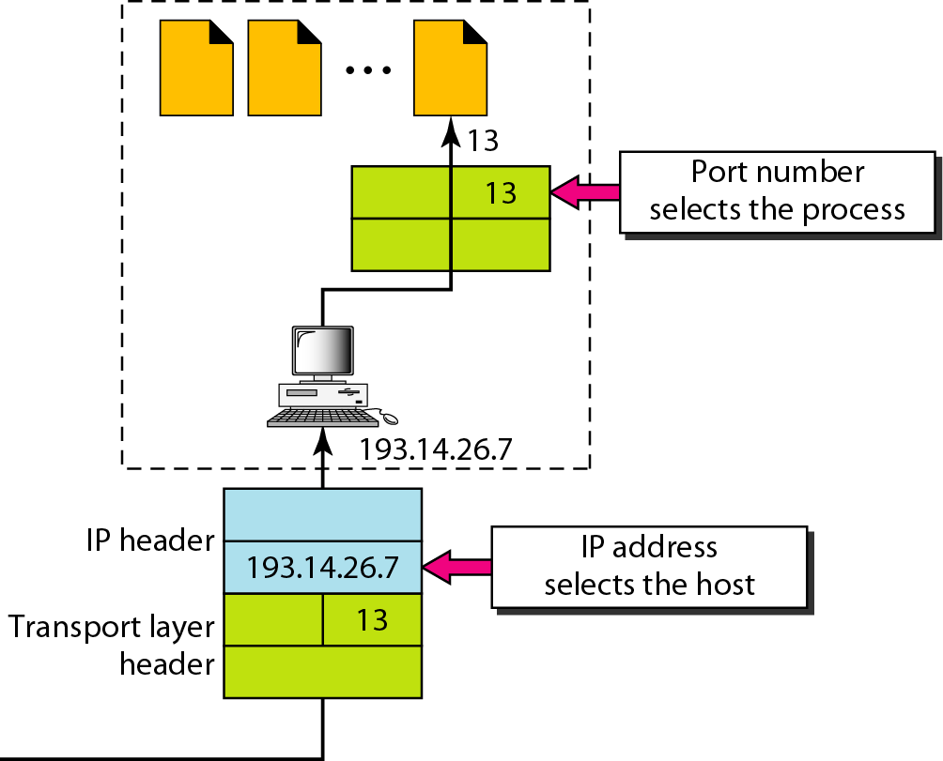
IP addresses versus port numbers
23.2

Slide 7
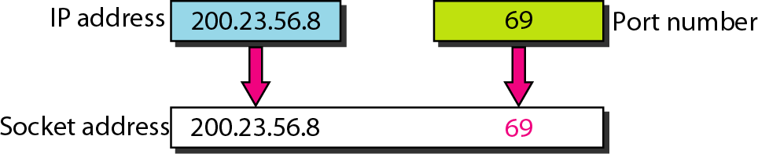
Socket address
23.2

Slide 8
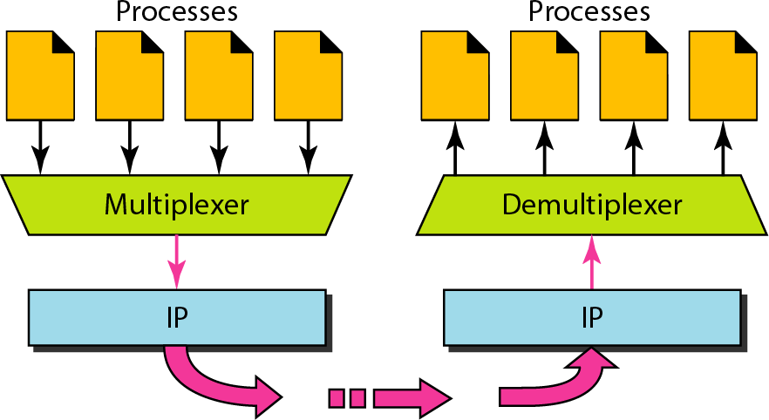
Multiplexing and demultiplexing
23.2

Slide 9
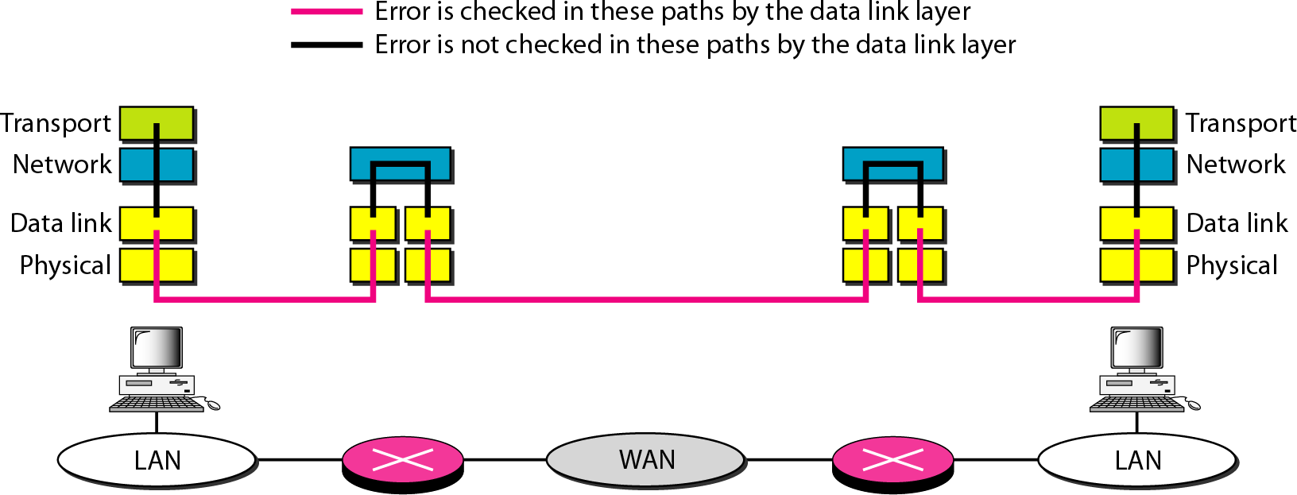
Reliable Vs Unreliable
Error control
23.2

Slide 10
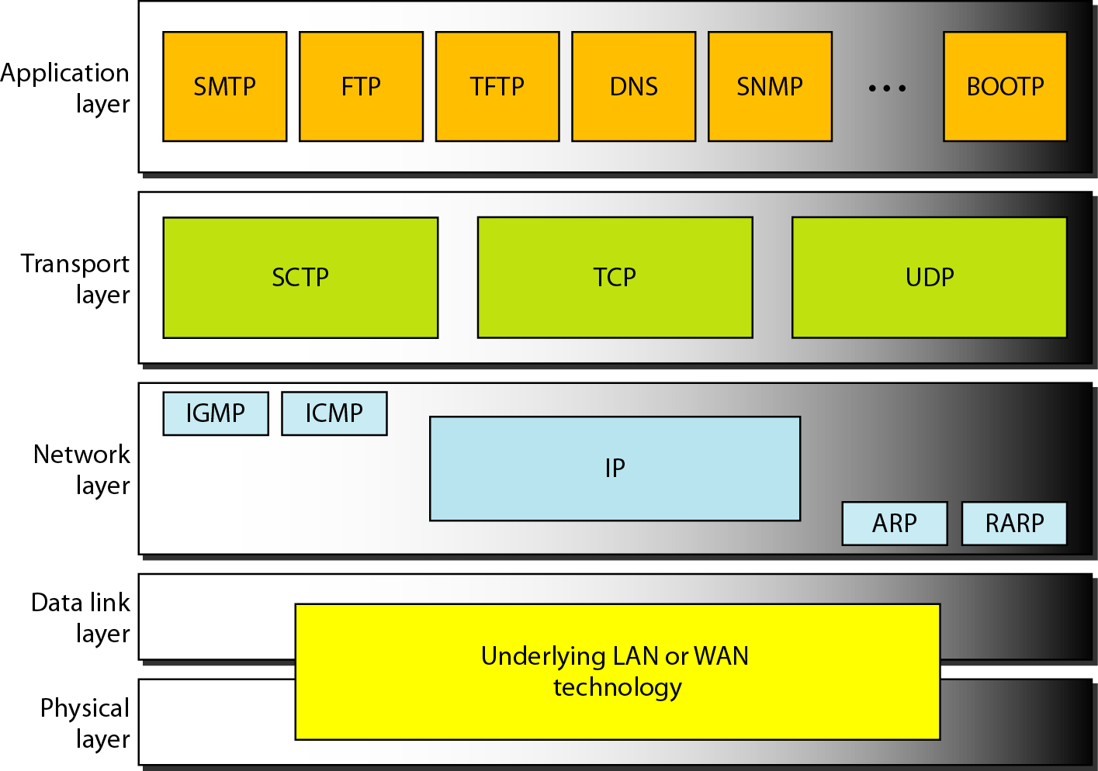
Position of UDP, TCP, and SCTP in TCP/IP suite

Slide 11















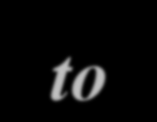













USER DATAGRAM PROTOCOL (UDP)
The User Datagram Protocol (UDP) is called a connectionless, unreliable transport protocol. It does not add anything to the services of IP except to provide process-to-process communication instead of host-to- host communication.
Topics discussed in this section:
Well-Known Ports for UDP
User Datagram Checksum UDP Operation Use of UDP

Slide 12
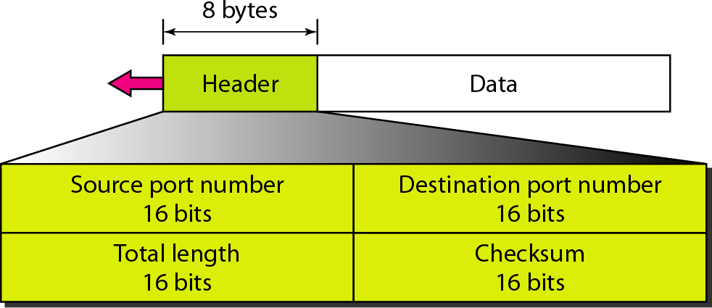
User datagram format

Slide 13
Note
UDP length
= IP length – IP header’s length

Slide 14
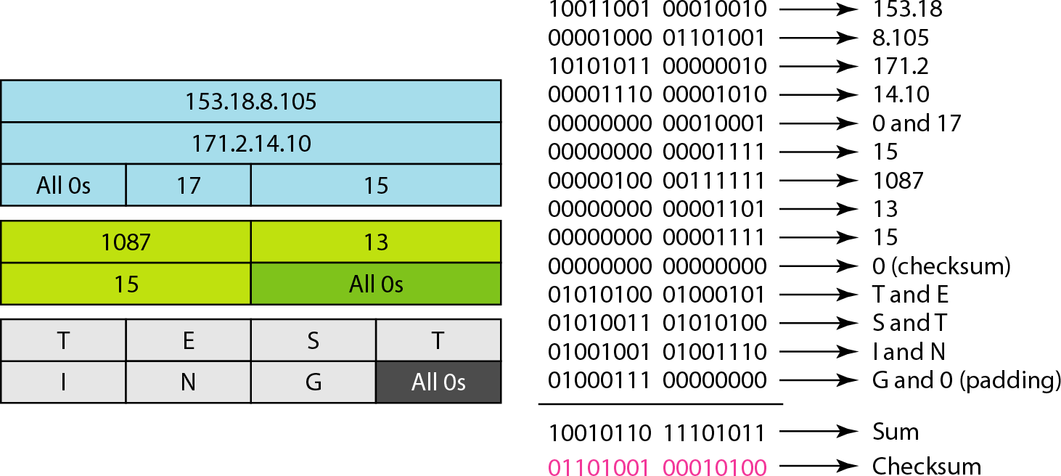
Checksum calculation of a simple UDP user datagram

Slide 15















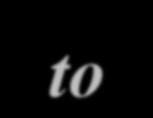
















Transmission Control Protocol (TCP)
TCP is a connection-oriented protocol; it creates a virtual connection between two TCPs to send data. In addition, TCP uses flow and error control mechanisms at the transport level.

Slide 16
TCP Services
Process to Process Communication
Stream Delivery Service
Sending and Receiving Buffers
Full Duplex Communication
Connection -Oriented Service
Reliable Service

Slide 17
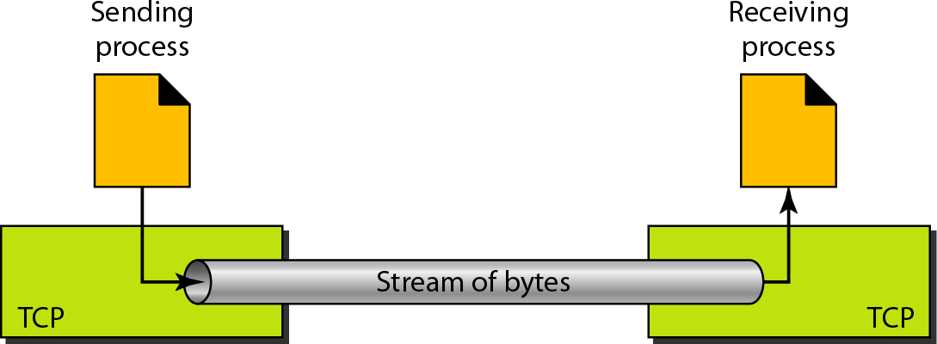
Stream delivery

Slide 18
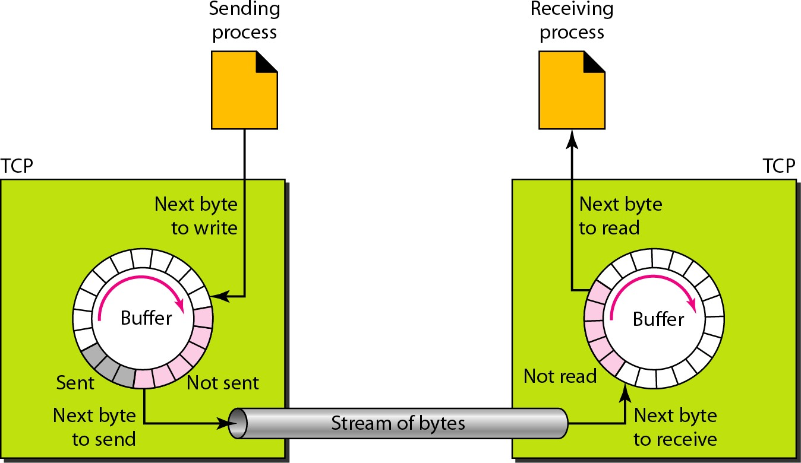
Sending and receiving buffers

Slide 19
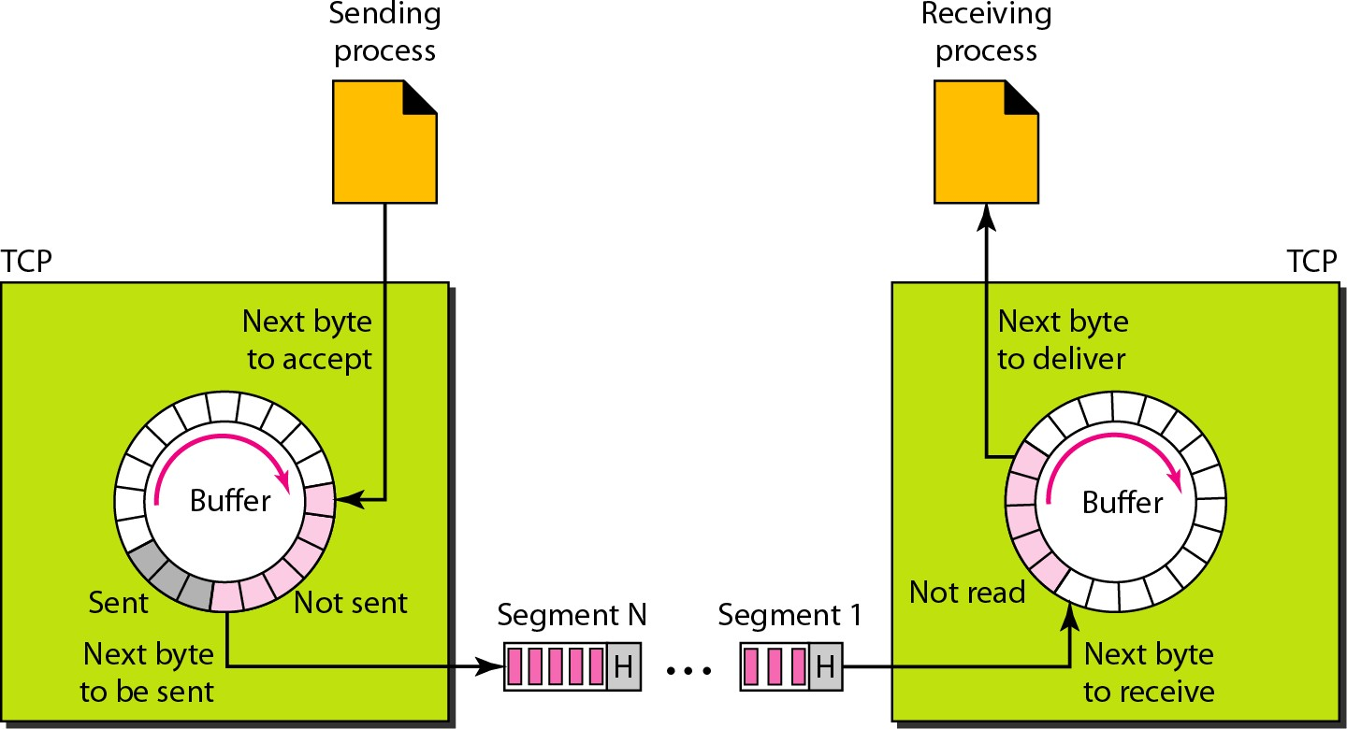
TCP segments

Slide 20
TCP Features
Numbering System
Flow Control
Error Control
Congestion Control

Slide 21
TCP Features
1. Numbering System
Byte Number
(TCP generates a random number b/w 0 to 2 32 -1)
Sequence Number

Slide 22
Note
The bytes of data being transferred in each connection are numbered by TCP. The numbering starts with a randomly generated number.

Slide 23
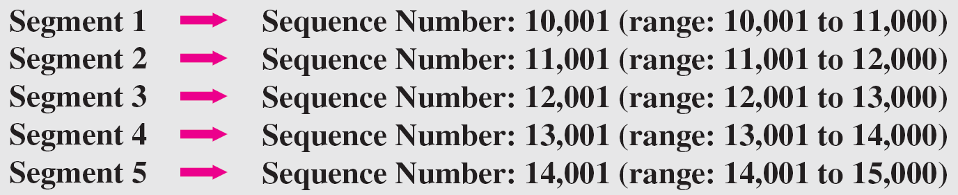
Example 23.3
Example
Suppose a TCP connection is transferring a file of 5000 bytes. The first byte is numbered 10,001. What are the sequence numbers for each segment if data are sent in five segments, each carrying 1000 bytes?
The following shows the sequence number for each segment:

Slide 24



Note
The value in the sequence number field of a segment defines the
number of the first data byte contained in that segment.

Slide 25
The value of the acknowledgment field in a segment defines
the number of the next byte a party expects to receive.
Note
The acknowledgment number is cumulative.

Slide 26
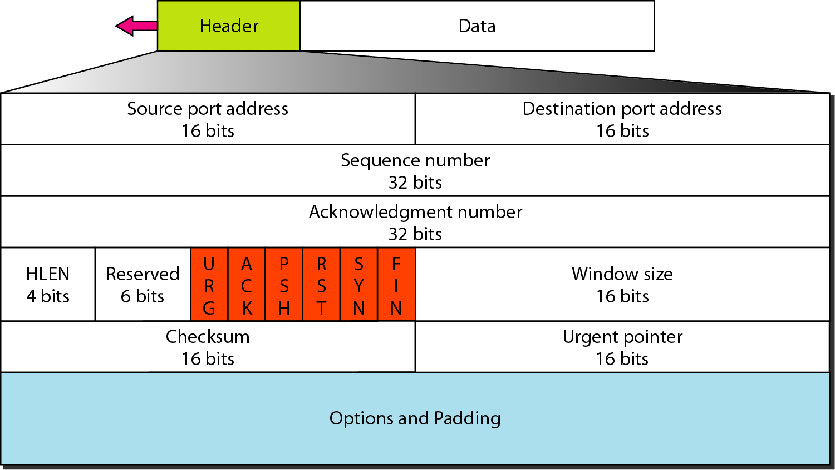
TCP segment format

Slide 27
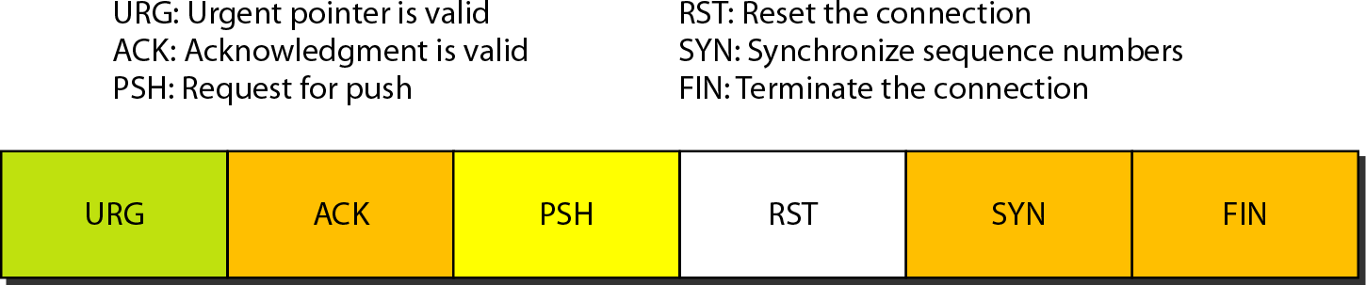
Figure 23.17 Control field

Slide 28
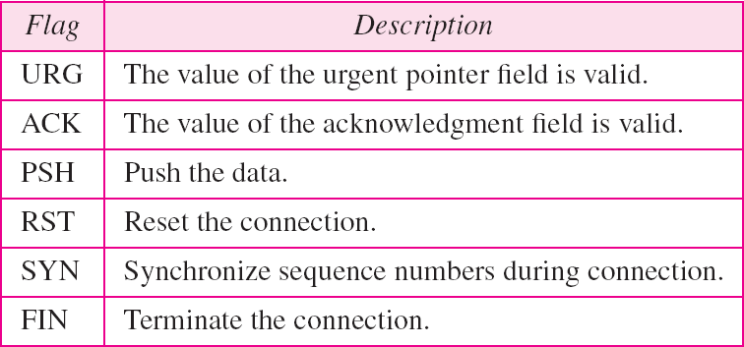
Table 23.3 Description of flags in the control field

Slide 29
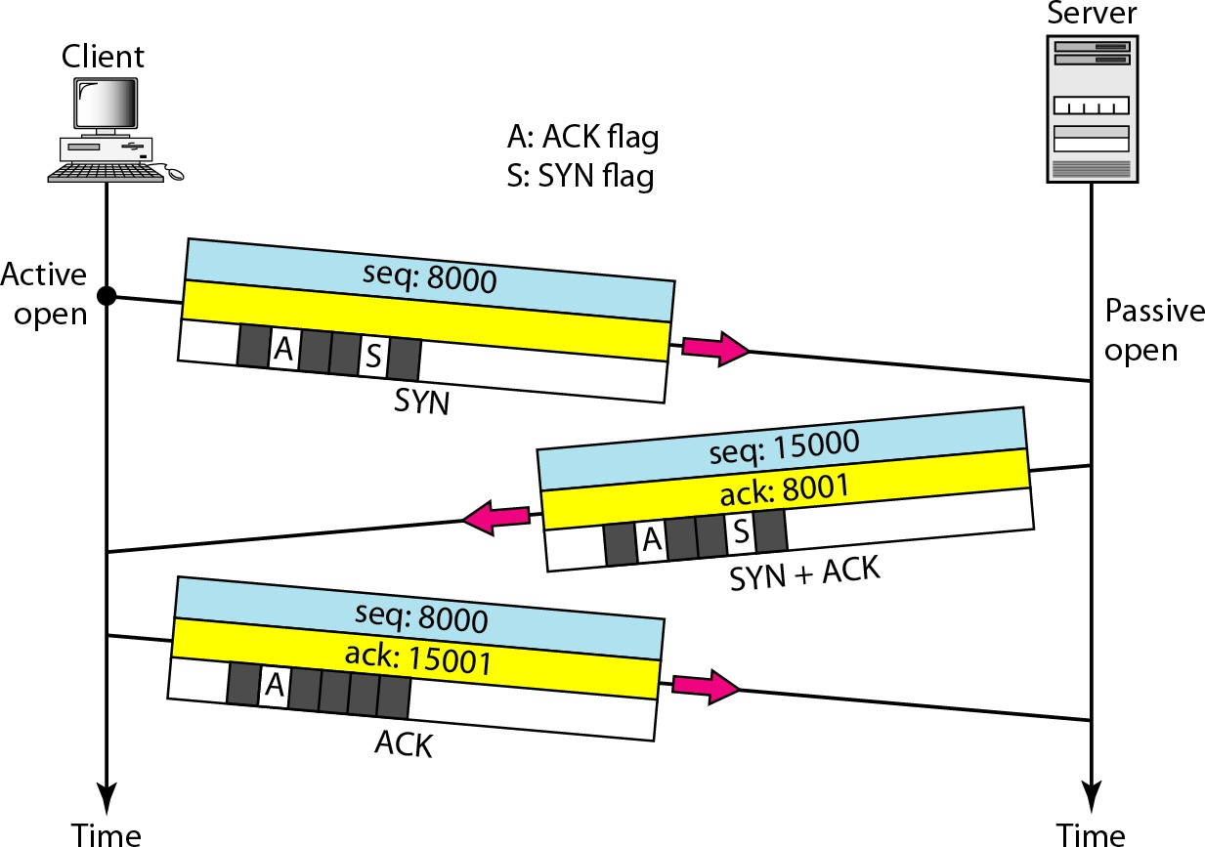
Connection establishment using three-way handshaking

Slide 30
Note
A SYN segment cannot carry data, but it consumes one sequence number.

Slide 31
Note
A SYN + ACK segment cannot carry data, but does consume one sequence number.

Slide 32
Note
An ACK segment, if carrying no data, consumes no sequence number.

Slide 33
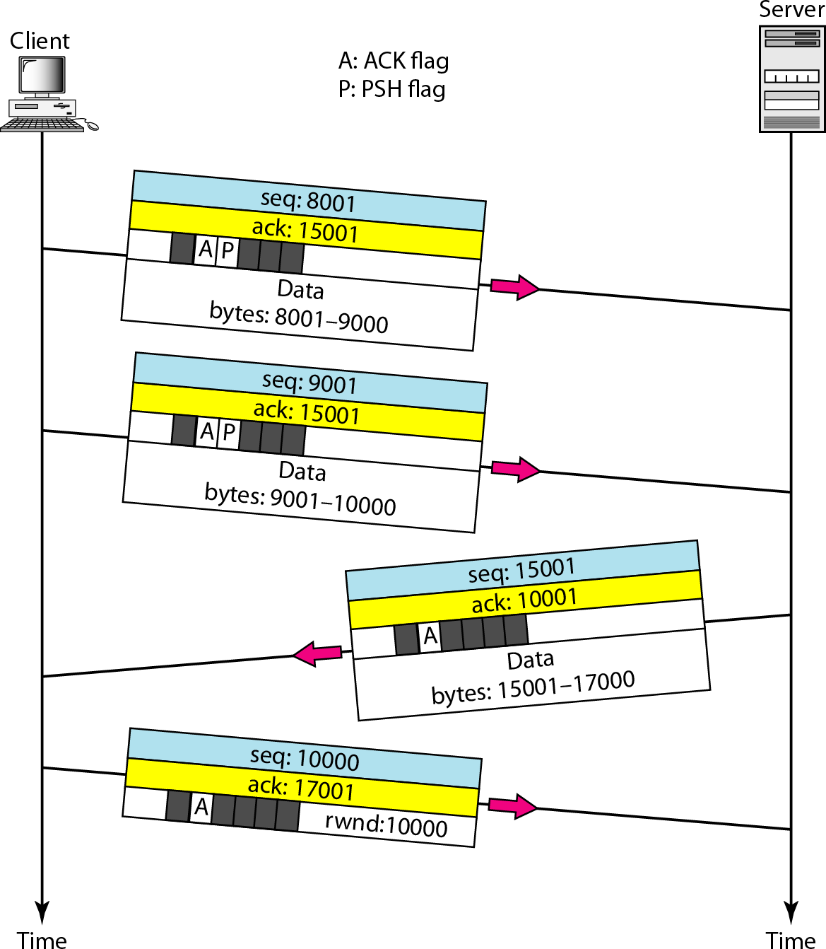
Figure 23.19 Data transfer

Slide 34
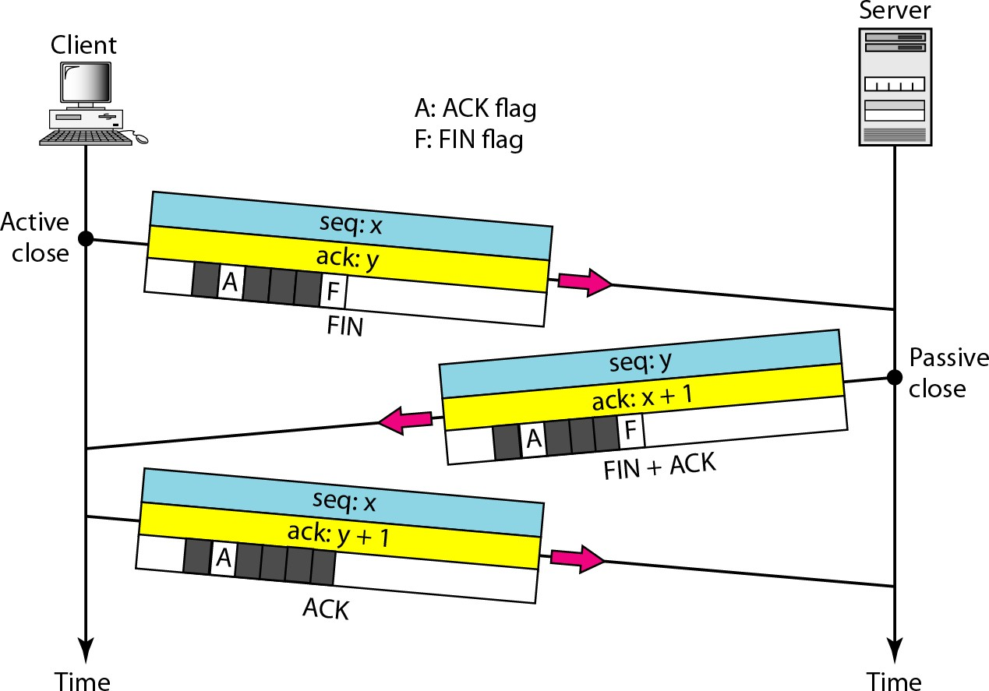
Figure 23.20 Connection termination using three-way handshaking

Slide 35
Note
The FIN segment consumes one sequence number if it does
not carry data.

Slide 36
Note
The FIN + ACK segment consumes one sequence number if it
does not carry data.

Slide 37
Question
Q:1 Explain TCP segment and UDP datagram format in detail. Q:2 Explain TCP sending and receiving buffer with diagram.

Slide 38




















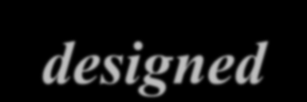





















SCTP
Stream Control Transmission Protocol (SCTP) is a new reliable, message-oriented transport layer
protocol. SCTP, Internet
however, is
mostly have
designed for recently been
applications
that
introduced. These
new applications need a more
sophisticated service than TCP can provide. Topics discussed in this section:
SCTP Services and Features Packet Format
An SCTP Association
Flow Control and Error Control

Slide 39
Note
SCTP is a message-oriented, reliable protocol that combines the best features of UDP and TCP.

Slide 40
SCTP Services
Process-to-Process Communication
Multiple Streams
Multihoming
Full-Duplex Communication Connection-Oriented Service Reliable Service

Slide 41
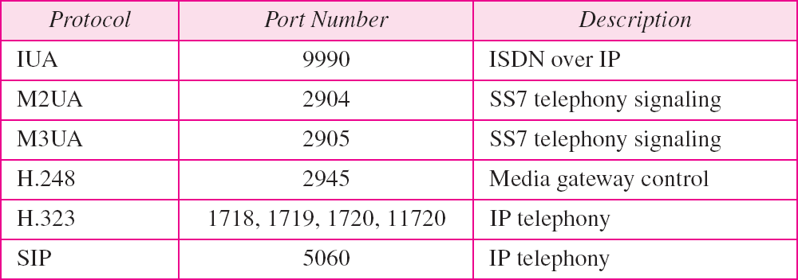
Table 23.4 Some SCTP applications

Slide 42
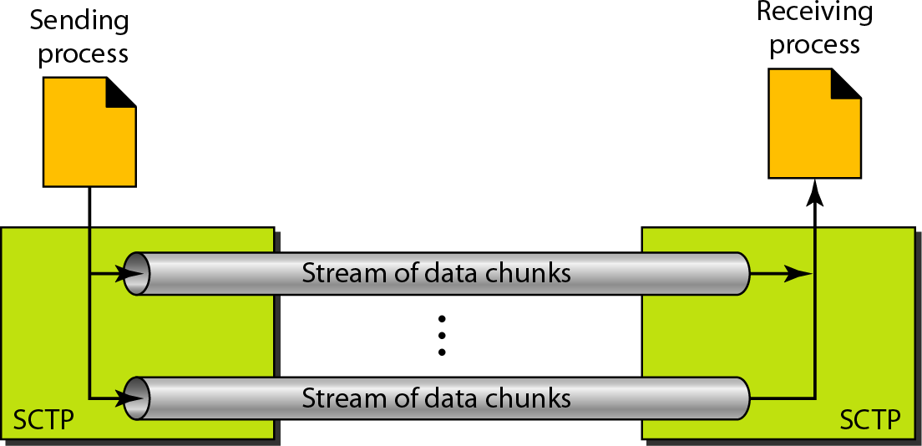
Figure 23.27 Multiple-stream concept

Slide 43
Note
An association in SCTP can involve multiple streams.

Slide 44
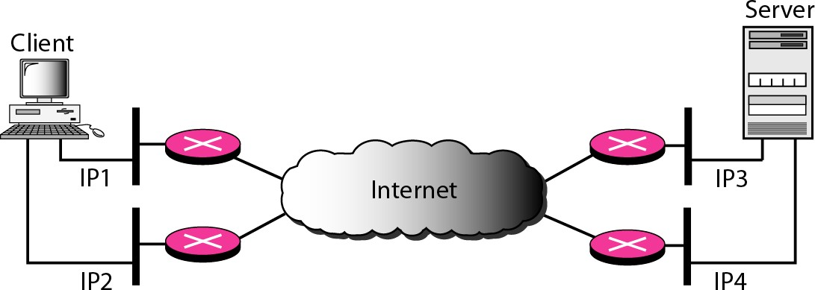
Figure 23.28 Multihoming concept

Slide 45
Note
SCTP association allows multiple IP addresses for each end.

Slide 46
SCTP Features
Transmission Sequence Number
Stream Identifier
Stream Sequence Number Packets
Acknowledgment Number Flow Control
Error Control
Congestion Control

Slide 47
SCTP Features
Transmission Sequence Number
The unit of data in TCP is a byte. Data transfer in TCP is controlled by numbering bytes by using a sequence number.
The unit of data in SCTP is a DATA chunk.
SCTP uses a transmission sequence number (TSN) to number the data chunks. TSNs are 32 bits long and randomly initialized between 0 and 2³² - 1.

Slide 48
Note
In SCTP, a data chunk is numbered using a TSN.
TSN: Transmission Sequence Number

Slide 49
SCTP Features
Stream Identifier
In TCP, there is only one stream in each connection.
In SCTP, there may be several streams in each association.
Each stream in SCTP needs to be identified by using a stream identifier (SI).

Slide 50
Note
To distinguish between different streams, SCTP uses an SI.

Slide 51
SCTP Features
Stream Sequence Number
When a data chunk arrives at the destination SCTP, it is delivered to the appropriate stream and in the proper order.
SCTP defines each data chunk in each stream with a stream sequence number (SSN).

Slide 52
Note
To distinguish between different data chunks belonging to the same stream, SCTP uses SSNs.
SSN : Stream sequence number

Slide 53
SCTP Features
Packets
TCP has segments; SCTP has packets.

Slide 54
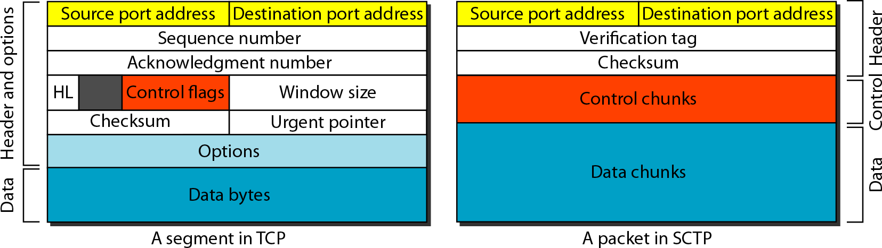
Figure 23.29 Comparison between a TCP segment and an SCTP packet

Slide 55
Note
In SCTP, control information and data information are carried in separate chunks.

Slide 56
Example
let us suppose that process A needs to send 11 messages to process B in three streams.
The first four messages are in the first stream, the second three messages are in the second stream, and the last four messages are in the third stream.
we assume that each message fits into one data chunk. Therefore, we have 11 data chunks in three streams.
We also assume that the network allows only three data chunks per packet, which
means that we need.

Slide 57
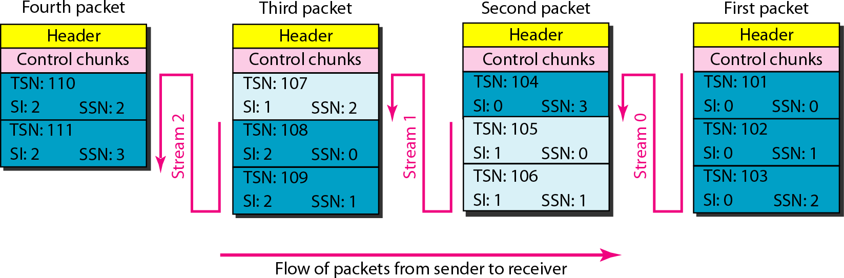
Figure 23.30 Packet, data chunks, and streams

Slide 58
Data chunks are identified by three items: TSN, SI, and SSN.
TSN is a cumulative number identifying the association; SI defines the stream; SSN defines the chunk in a stream.
Note

Slide 59
Note
In SCTP, acknowledgment numbers are used to acknowledge only data chunks; control chunks are acknowledged by other control chunks if necessary.

Slide 60
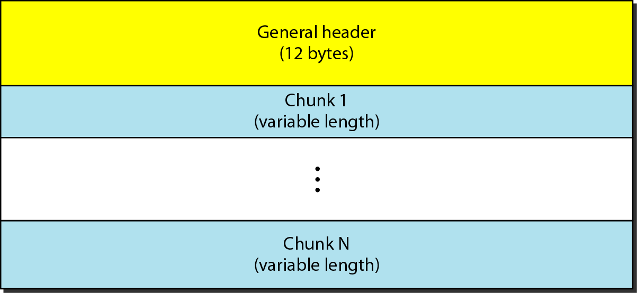
Figure 23.31 SCTP packet format

Slide 61
Note
In an SCTP packet, control chunks come before data chunks.

Slide 62
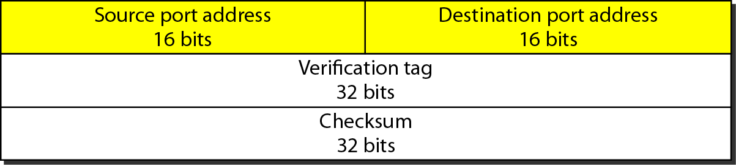
Figure 23.32 General header

Slide 63
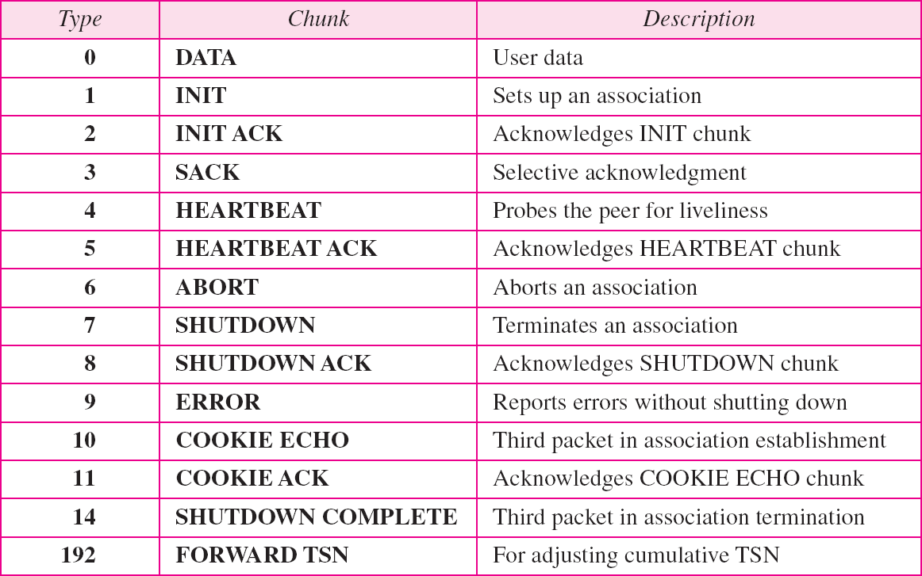
Table 23.5 Chunks

Slide 64
Note
A connection in SCTP is called an association.

Slide 65
Note
No other chunk is allowed in a packet carrying an INIT or INIT ACK chunk.
A COOKIE ECHO or a COOKIE ACK
chunk can carry data chunks.

Slide 66
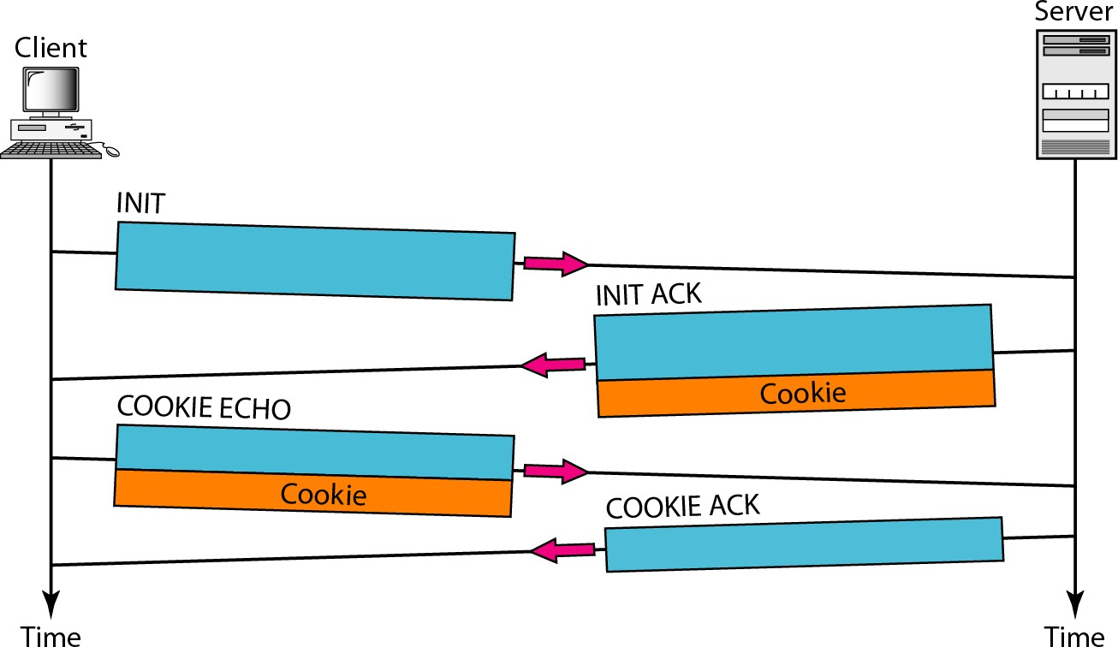
Figure 23.33 Four-way handshaking

Slide 67
Note
In SCTP, only DATA chunks consume TSNs;
DATA chunks are the only chunks that are acknowledged.

Slide 68
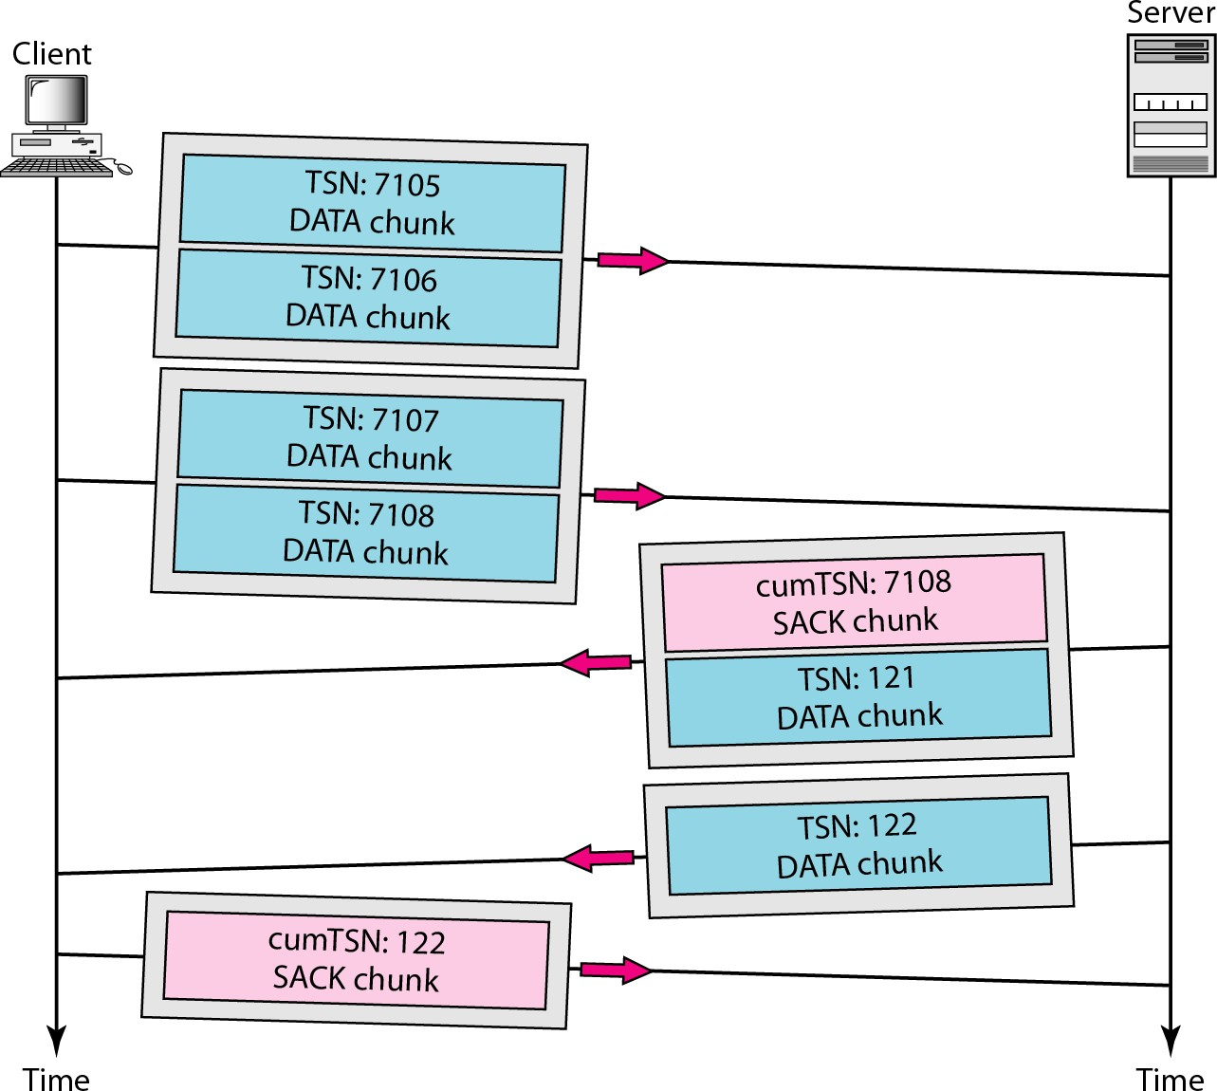
Figure 23.34 Simple data transfer

Slide 69
Note
The acknowledgment in SCTP defines the cumulative TSN, the TSN of the last data chunk received in order.

Slide 70
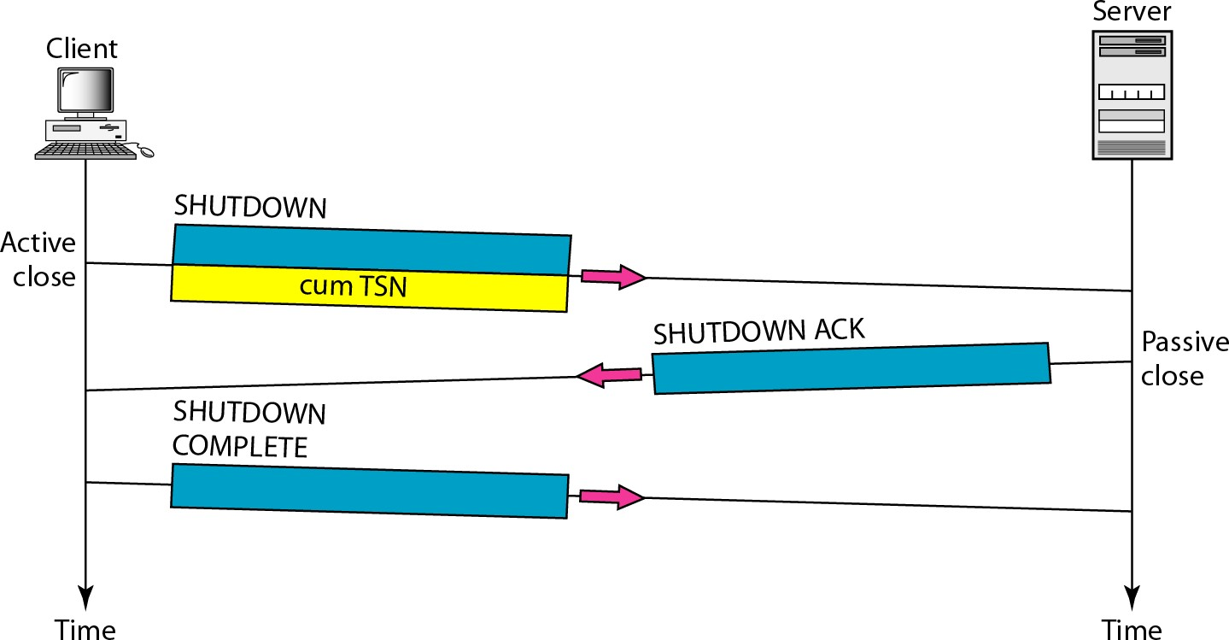
Figure 23.35 Association termination

Slide 71
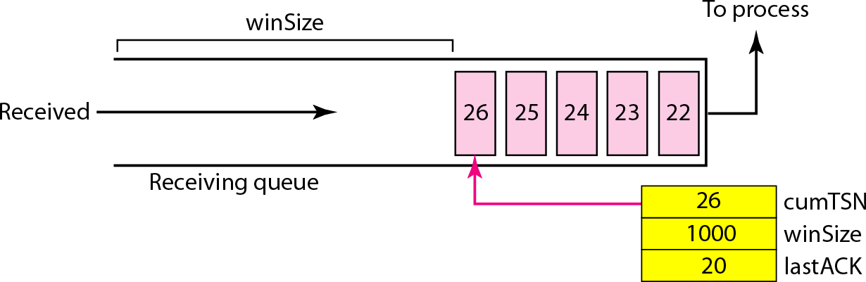
Figure 23.36 Flow control, receiver site

Slide 72
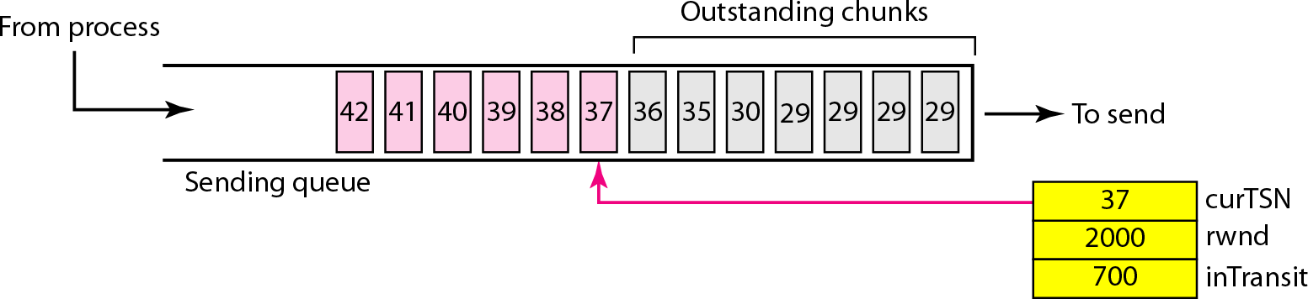
Figure 23.37 Flow control, sender site

Slide 73
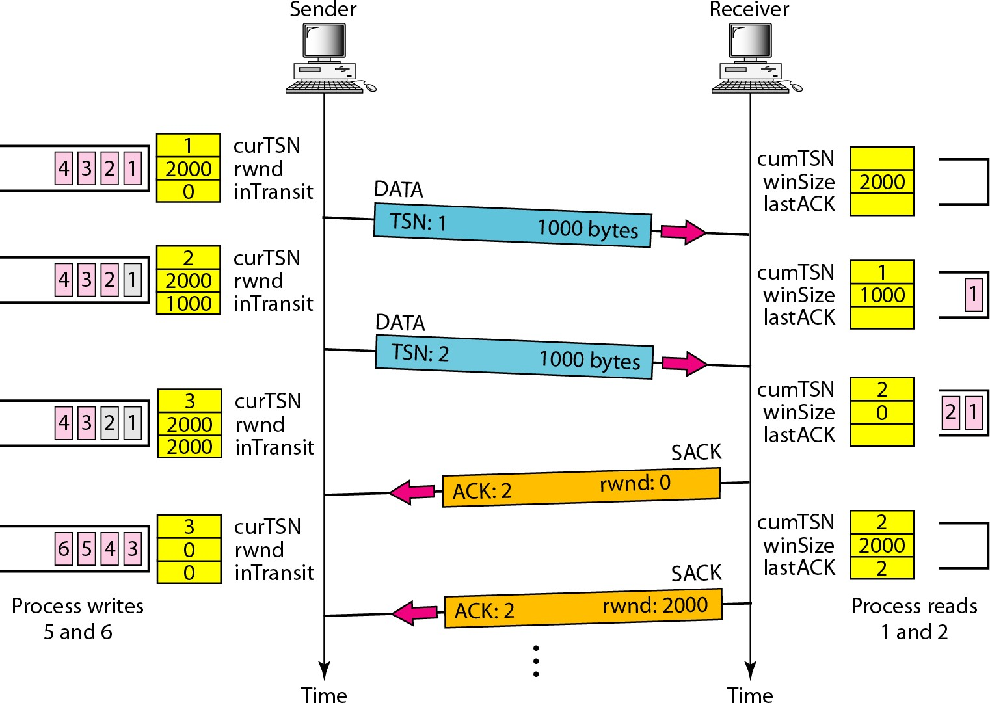
Figure 23.38 Flow control scenario

Slide 74
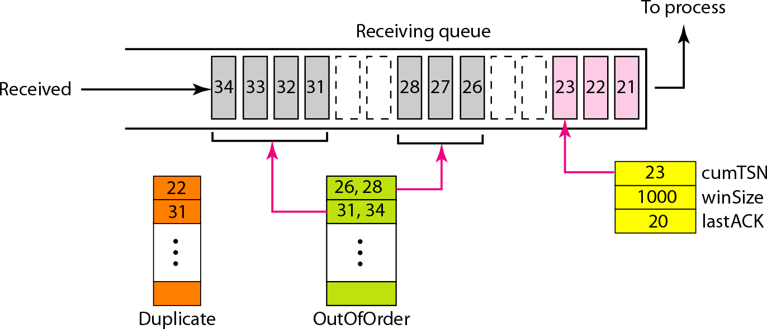
Figure 23.39 Error control, receiver site

Slide 75
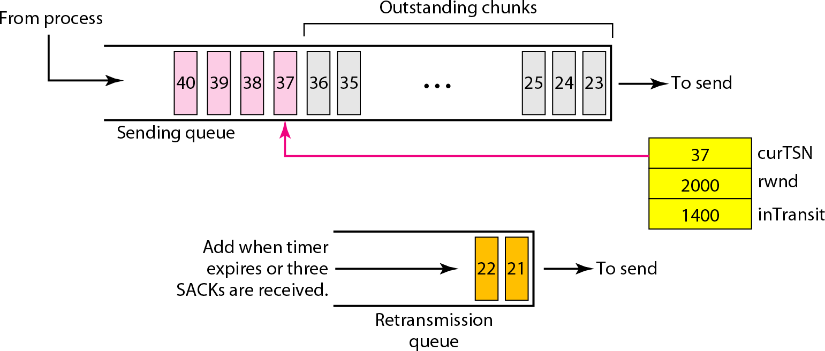
Figure 23.40 Error control, sender site

Slide 76
Figure 23.40 Error control, sender site

